Slide 1

FOOD FRESHNESS DETECTION

Slide 2

PROBLEM STATEMENT:
Food often spoils without being noticed, causing waste and health issues. People need an easy way to check if their food is still fresh. This project aims to build a system that detects the freshness of food using images and shows the result on a refrigerator screen. It helps users know when to consume or remove spoiled food.
OBJECTIVE:
The objective of this project is to develop a system that uses machine learning to detect the freshness of food items. The system will analyze food images, assess their freshness, and display the results on the screen of a smart refrigerator. This will help users monitor food condition in real-time, reduce food waste, and ensure food safety.

Slide 3


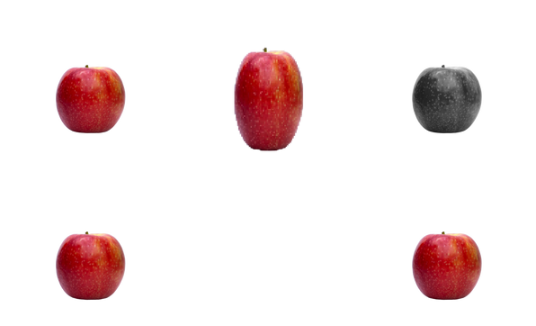


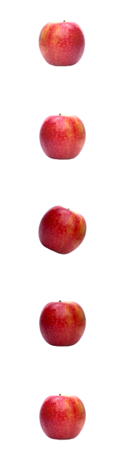
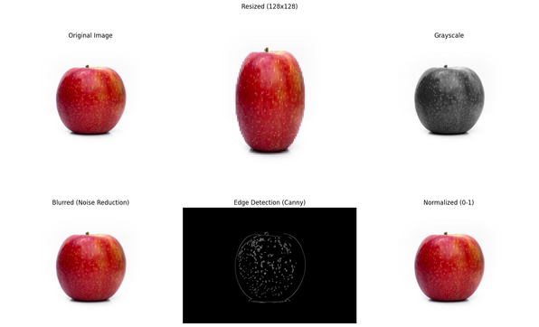






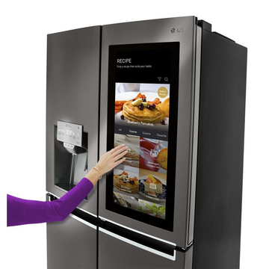
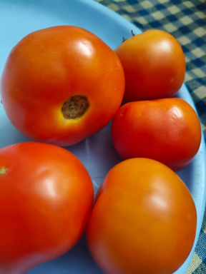
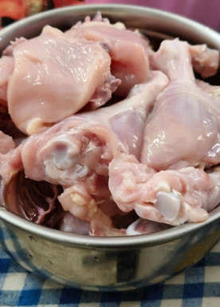

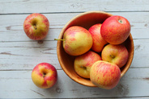


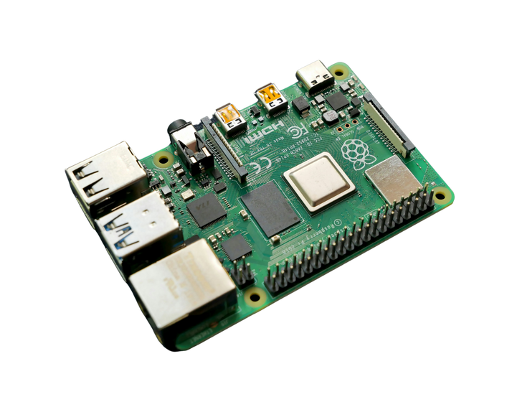

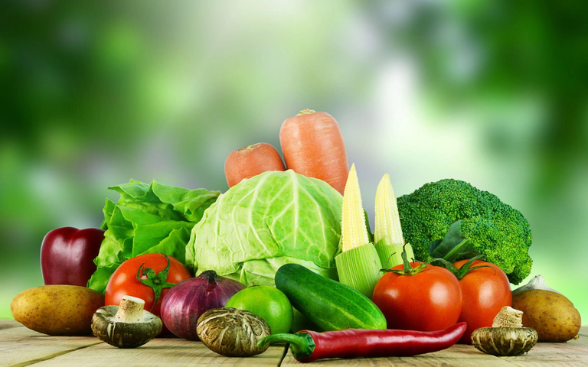
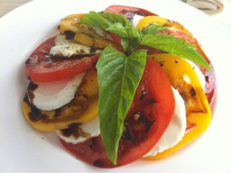
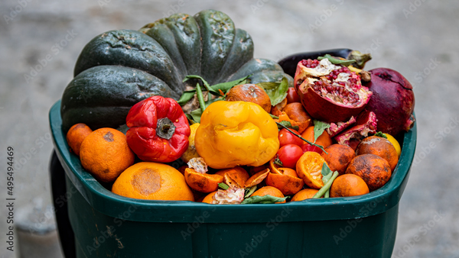
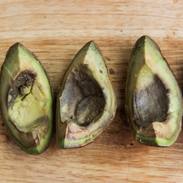
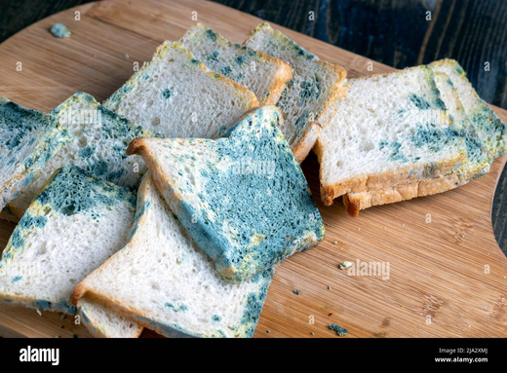
PROPOSED METHODLOGY
DATA PREPROCESSING
Resized (128 x 128)
DATA AUGMENTATION
Original Image
Garyscale
Original Image
Flipping
Rotation
TRAIN DATA
MODEL
TRAINING
PERFORMANCE
EVALUATION
Blurred (Noise Reduction)
Edge detection (Canny)
Normalized (0-1)
Brightness increase
180° Rotation
SPLITTING INTO TRAIN AND TEST DATA
IMAGE CAPTURES
TEST DATA
CAMERA MODULE
PREDICTION
MODEL
DATA LABELLING
DISPLAY ON THE REFRIGERATOR
IoT SENSORS
CLASSIFICATION
Tomato
Apples
Raw Chicken
RASPBERRY PI
FRESH
SLIGHTLY AGED
STALE
SPOILED
ROTTEN
Fig 1 : Proposed Methodology
DATA SET

Slide 4
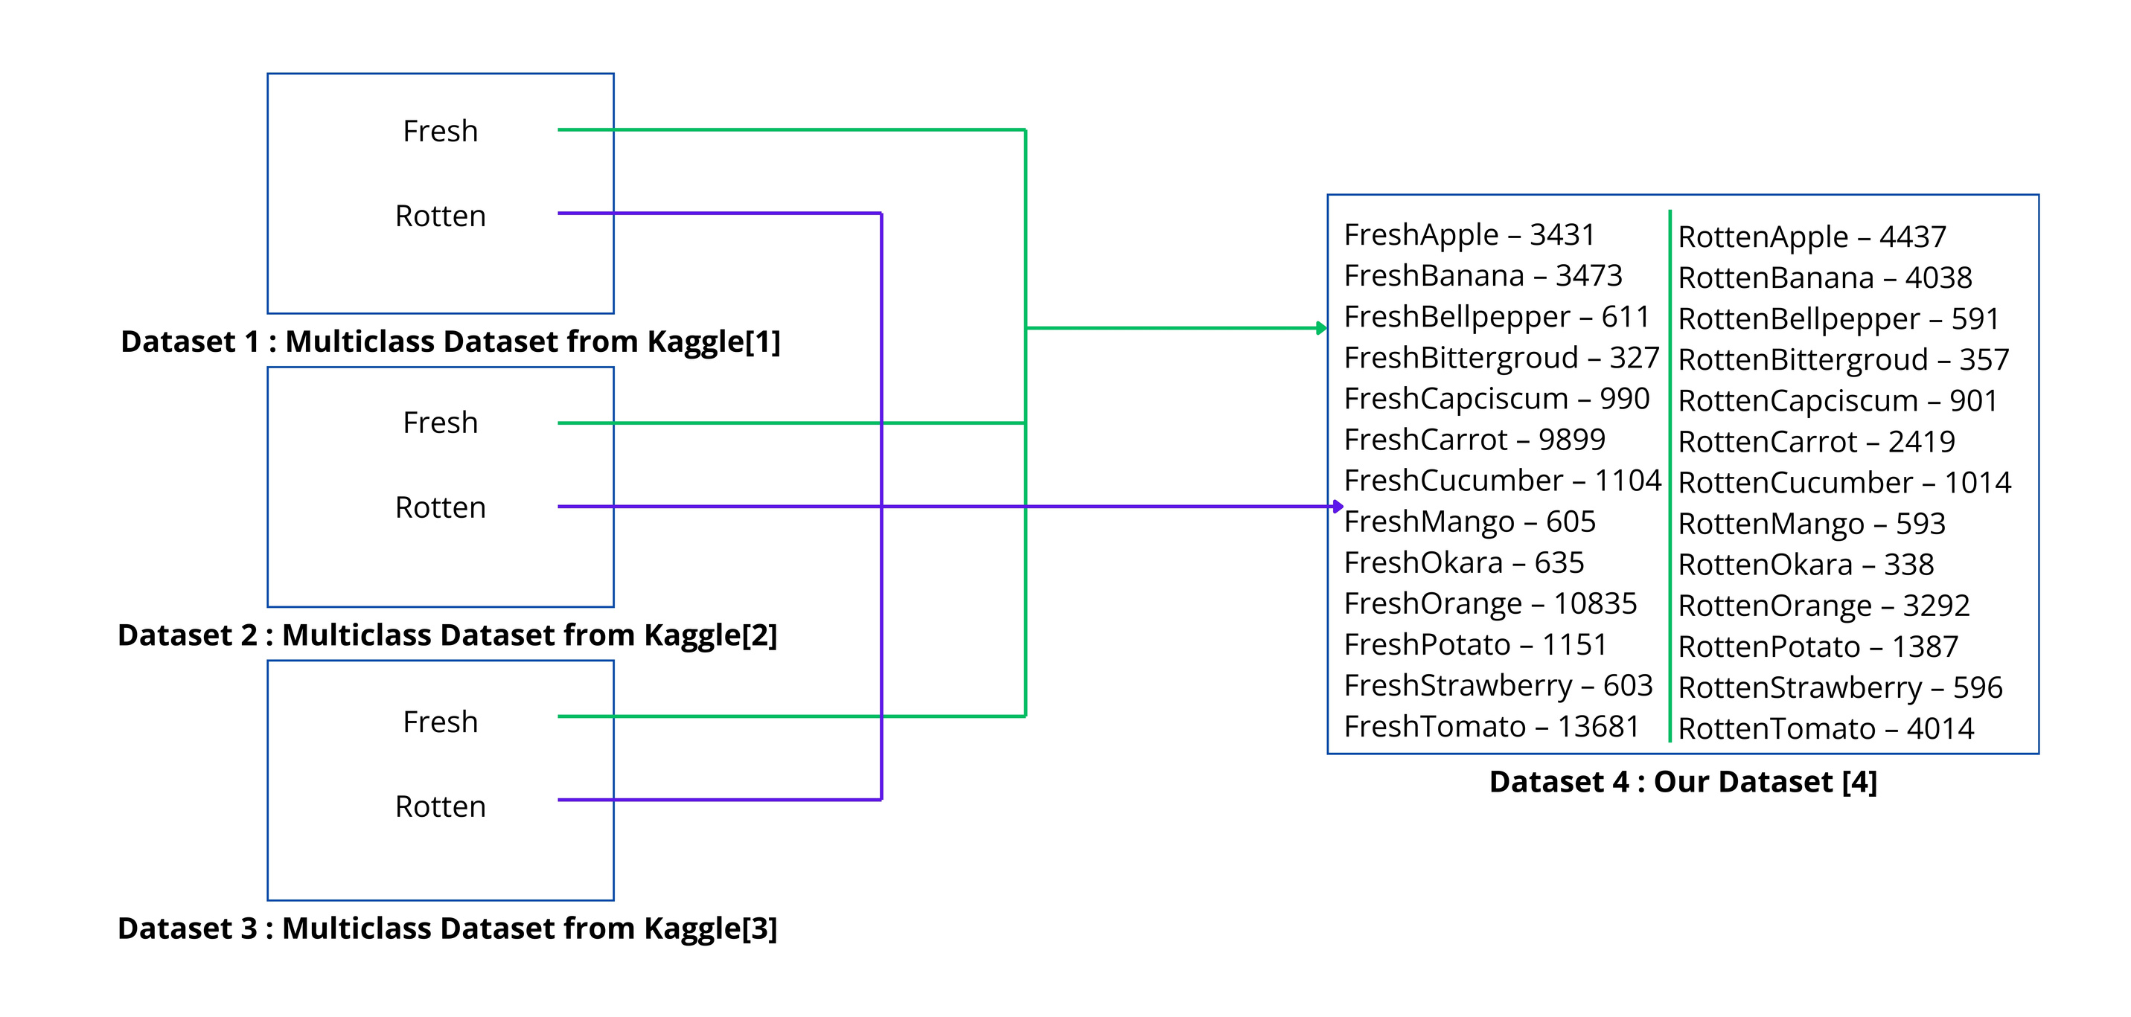
DATASET:
Fig 2 : Dataset Preparation
Three different food image datasets were used: [1], [2], and [3].
Selected and organized images from these datasets to create one final combined dataset.
The final dataset has two main folders:
Fresh
Rotten
Each folder contains 13 common subfolders based on food categories:
apple, banana, bell pepper, bitter gourd, capsicum, carrot, cucumber, mango, okra, orange, potato, strawberry, tomato
This results in 26 subfolders in total (13 for Fresh + 13 for Rotten).
To address class imbalance, 100 images were selected from each subfolder.
Final dataset size: 2,600 images (26 subfolders × 100 images).
Labels were assigned based on the source dataset:
Dataset 1 → Label 1
Dataset 2 → Label 2
Dataset 3 → Label 3
Combined dataset → Label 4

Slide 5
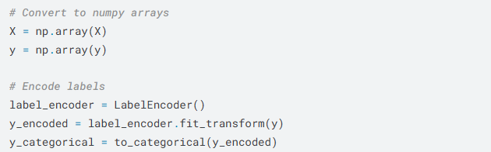
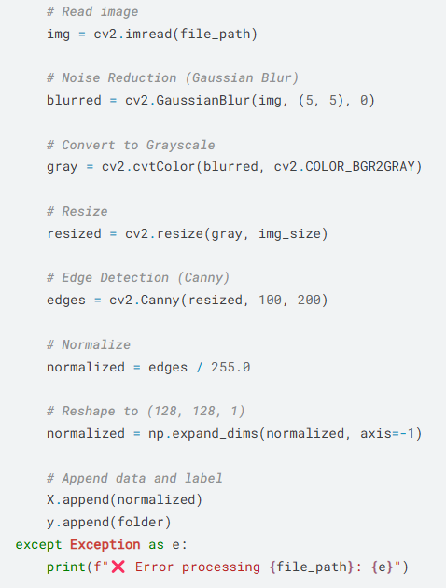
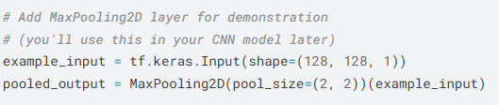
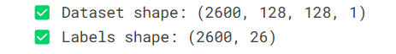
DATA PREPROCESSING:
📈 Why Preprocessing is Important for Our Project:
- Ensures all images are uniform and clean.
- Reduces computational complexity.
- Enhances model ability to extract meaningful features
(edges, textures, shapes).
- Improves overall training performance and accuracy.
3

Slide 6
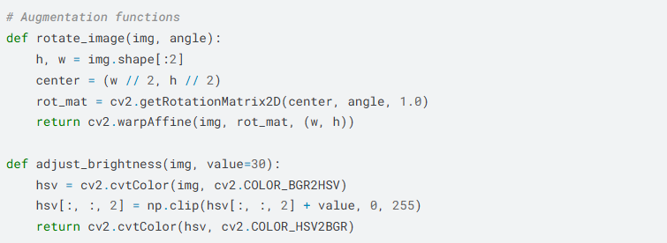
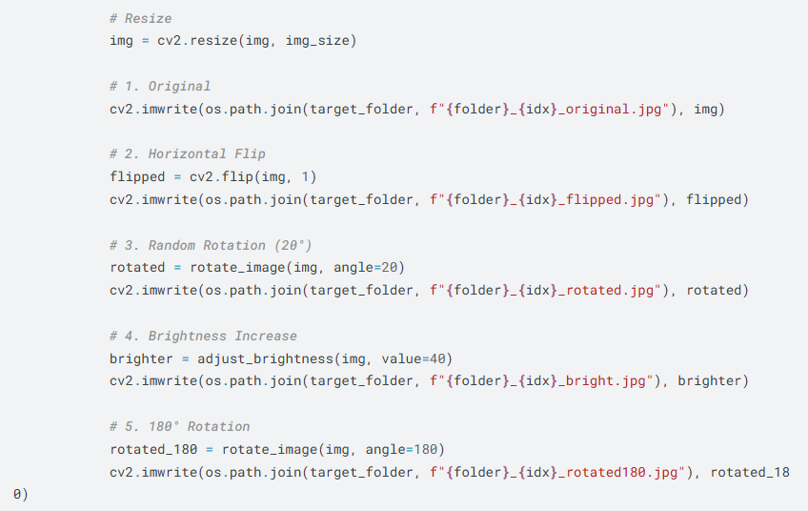
DATA AUGUMENTATION:
🚀 Why Augmentation is Important for Our Project:
- Increases training data without additional collection effort.
- Reduces overfitting by exposing the model to diverse examples.
- Makes he model more robust to different camera angles, lighting, and positioning.

Slide 7
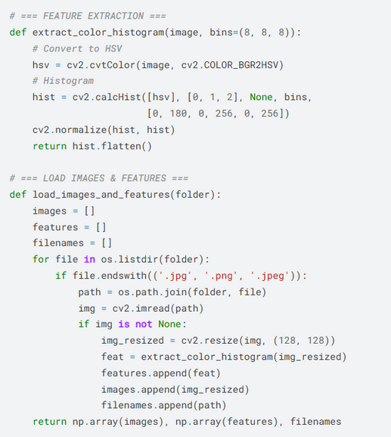
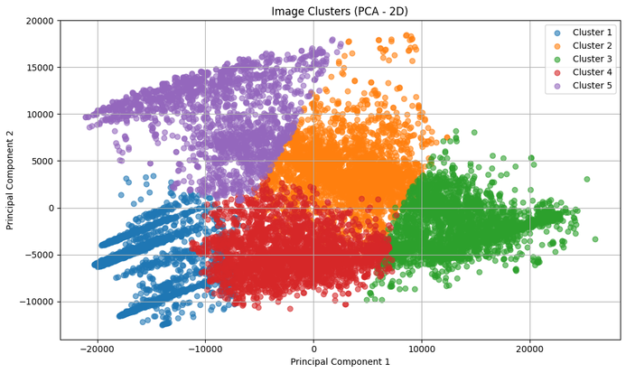
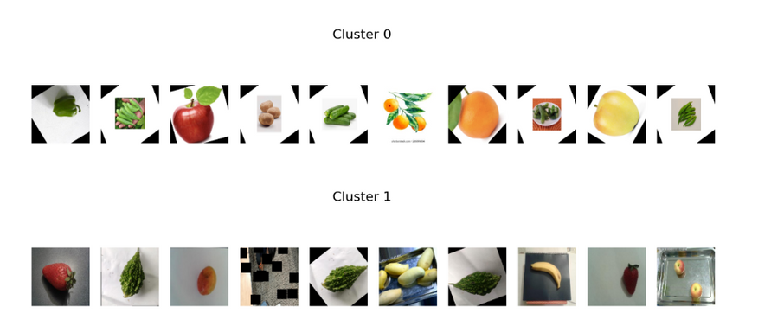
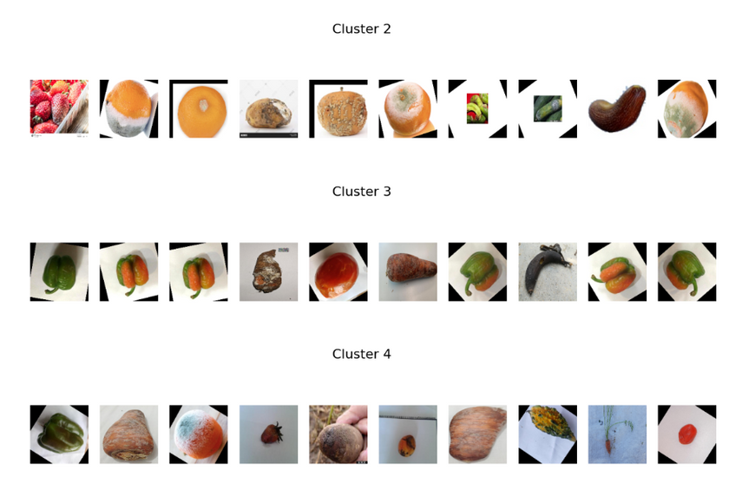
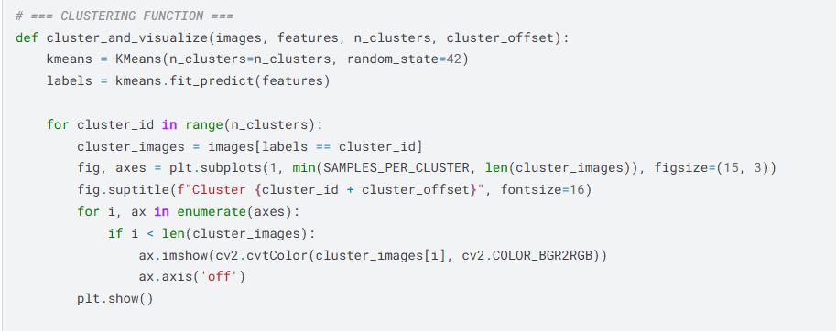
CLUSTERING:
Fig 3(a) : Visualization of Clusters = 5
Fig 3(b) : Clustered Images; Fresh - 2 Clusters , Rotten - 3 Clusters

Slide 8
REFERENCES
[1] https://www.kaggle.com/datasets/alinesellwia/food-freshness
[2] https://www.kaggle.com/datasets/swoyam2609/fresh-and-stale-classification
[3] https://www.kaggle.com/datasets/muhriddinmuxiddinov/fruits-and-vegetables-dataset
[4] https://www.kaggle.com/datasets/ulnnproject/food-freshness-dataset
[5] Bhuiyan, Zarif Wasif, et al. "IoT Based Meat Freshness Classification Using Deep Learning." IEEE Access (2024).
[6] Pazos, Jorge Felix Martínez, et al. "FRESHNets: Highly Accurate and Efficient Food Freshness Assessment Based on Deep Convolutional Neural Networks." Inteligencia Artificial 27.74 (2024): 48-61.
[7] Soomro, Muhammad Hanif, et al. "USE IMAGE PROCESSING MODEL TO FRUIT QUALITY DETECTION." Kashf Journal of Multidisciplinary Research 1.11 (2024): 85-106
[8] Rokhva, Shayan, Babak Teimourpour, and Amir Hossein Soltani. "Computer Vision in the Food Industry: Accurate, Real-time, and Automatic Food Recognition with Pretrained MobileNetV2." arXiv preprint arXiv:2405.11621 (2024).
[9] Sahin, Hasan Alp, and Hasan Onder. "Use Of Deep Learning To Determine The Freshness Of Egg." Journal of the Institute of Science and Technology 14.1 (2024): 493-500.

